Slide 1
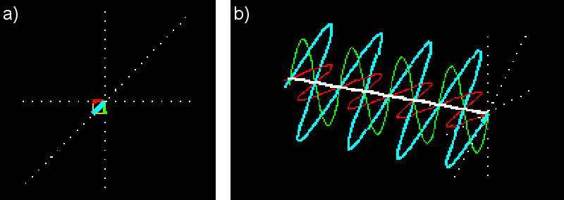
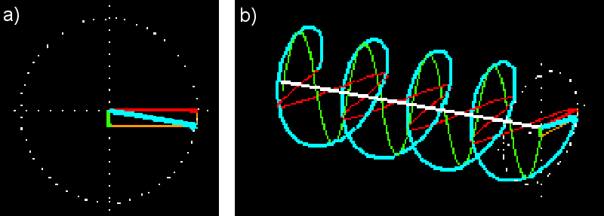
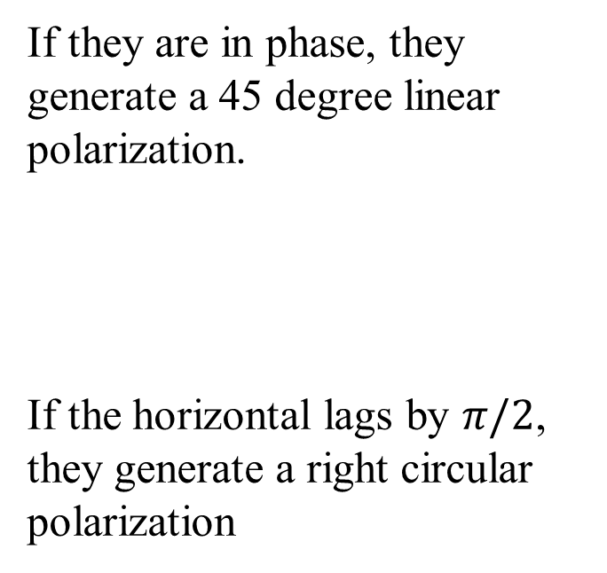
Polarizations of light
Any light polarization can be formed by the superposition of two orthogonal linear polarizations: horizontal and vertical polarization (red & green)
If they are in phase, they generate a 45 degree linear polarization.
If the horizontal lags by $π/2$, they generate a right circular polarization

Slide 2
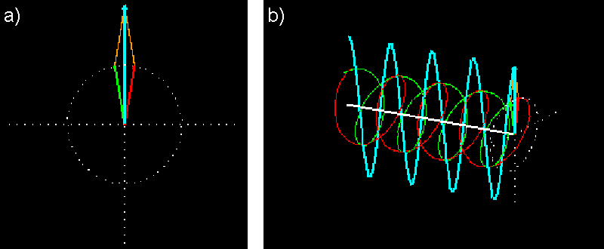
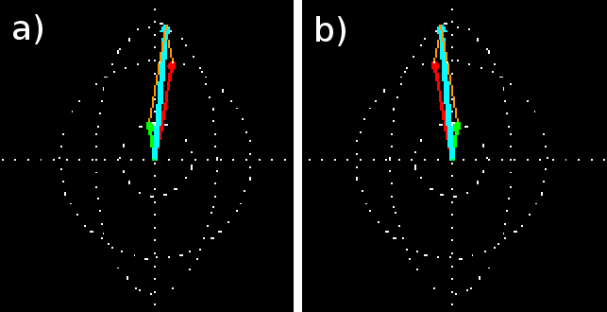
Polarizations of light
Any light polarization can also be formed by the superposition of two orthogonal circular polarizations: right- and left-circular polarization (red & green)
If they are in phase, we have
a linear polarization
If they are in phase but with different amplitude, we have a upright elliptical polarization

Slide 3
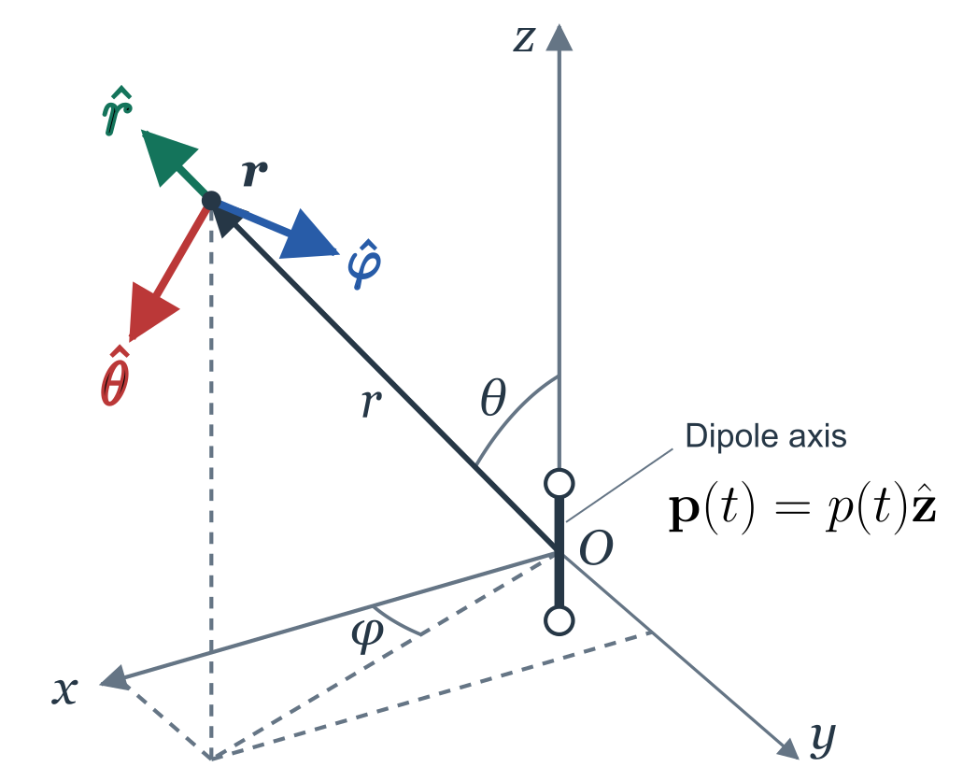
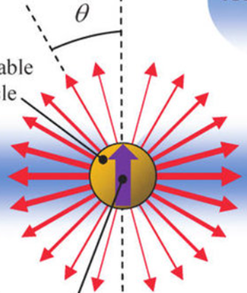
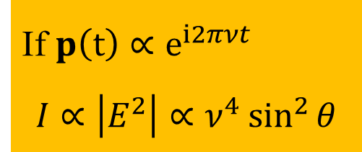
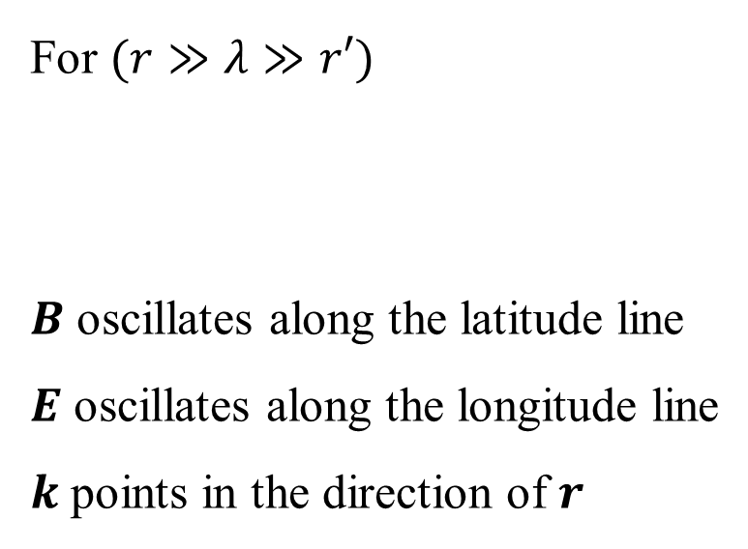
Dipole radiation
Electric Dipole: $p=qr′ r′\left(t\right):displacement of the charge at time t$
A vibrating charge induces vibrating E&M field at distance $r$
For $(r≫λ≫r′)$
$B$ oscillates along the latitude line
$E$ oscillates along the longitude line
$k$ points in the direction of $r$
If $p\left(t\right)∝e^{i2πνt}$
$$I∝\left|E^{2}\right|∝ν^{4}\sin^{2}{θ}$$

Slide 4
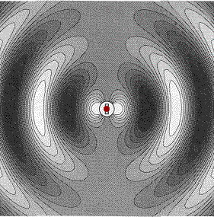
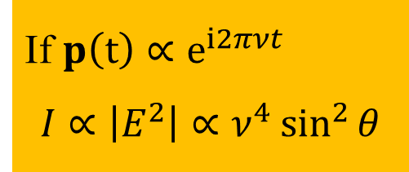
Dipole radiation
Electric Dipole: $p=qr′ r′\left(t\right):displacement of the charge at time t$
A vibrating charge induces vibrating E&M field at distance $r$
For $(r≫λ≫r′)$
$B$ oscillates along the latitude line
$E$ oscillates along the longitude line
$k$ points in the direction of $r$
If $p\left(t\right)∝e^{i2πνt}$
$$I∝\left|E^{2}\right|∝ν^{4}\sin^{2}{θ}$$

Slide 5
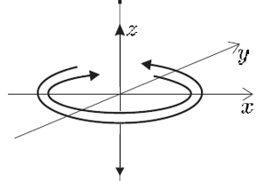
What is the electric field radiated by a dipole rotation on the x-y plane?

Slide 6
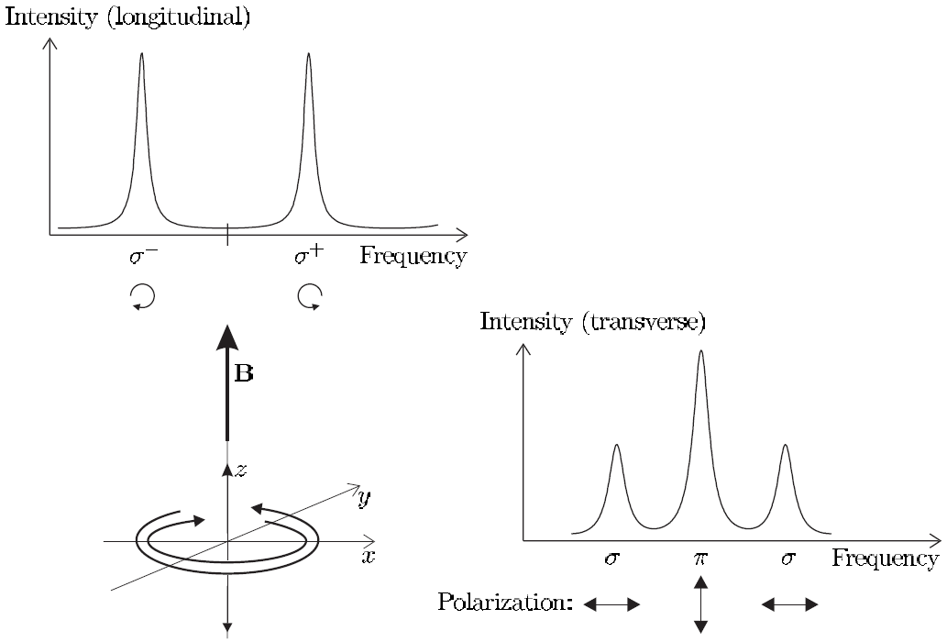

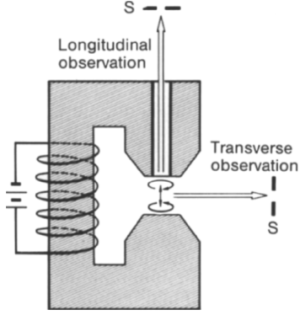
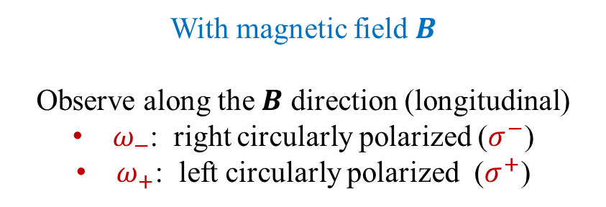

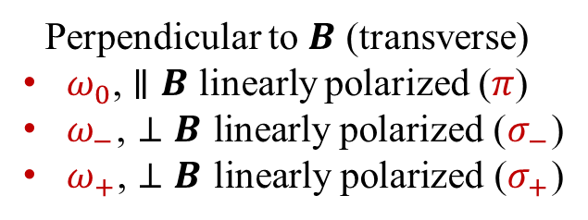

Zeeman effect（1896）and its classical (Lorentz) explanation
No magnetic field: unpolarized fluorescence of frequency $ω_{0}$ is observed from any direction.
With magnetic field $B$
Observe along the $B$ direction (longitudinal)
$ω_{−}$: right circularly polarized ($σ^{−}$)
$ω_{+}$: left circularly polarized ($σ^{+}$)
Perpendicular to $B$ (transverse)
$ω_{0}$, $∥B$ linearly polarized ($π$)
$ω_{−}$, $⊥B$ linearly polarized ($σ_{−}$)
$ω_{+}$, $⊥B$ linearly polarized ($σ_{+}$)
$$σ^{−}$$
$$σ^{+}$$

